Slide 1
Oral Presentation
Preparing and delivering FYP reports and other technical presentations
WEEK 9
Unit 7

Slide 2
Lesson Outline
Analysis of presentation task
Content organization
Delivery techniques and tips
Visual aids
Handling Q and A
Assignment 2 task

Slide 3
Activity 1: Know your purpose, audience and context
Purpose
Audience
Context
Q1: What is the purpose of your FYP presentation?
Q3: What is the appropriate style and tone?
Q2: Who is your audience?

Slide 4
Know your purpose, audience and context
Purpose:
To share research, persuade, inform
Audience:
Assessors
Professors
Context:
Formal

Slide 5
Oral Presentation: Three main components
Oral Presentation
Content
Delivery
Visual aids

Slide 6
Content Organization

Slide 7
IBC Approach: An Outline for your OP
Introduction
Attention grabber
Body
Main point 1 and supporting points
Main point 2 and supporting points
Conclusion
Preview of OP
Purpose/Key message
Summary of main points
Reiterate purpose/Key message
Q and A
Main point 3 and supporting points

Slide 8
Attention grabbers
Opening tactic that captures the imagination
Brief, catchy, well-rehearsed and relevant
At the start of a talk
Activity 2: Provide some examples of attention grabbers

Slide 9
Activity 3: Analysing Assignment 2 (OP)
What are the important instructions?
Provide an outline for your coming OP. Post it via Padlet: https://padlet.com/chengcp2018/oral-presentation-outline-zp1ocozdoqm3ov2p
NB. All posts will be deleted after this class, please save your outline for your own use.

Slide 10
OP outline using IBC approach
Introduction
AG
Key message
Body
Main point 1
Supporting points 1 (evidence, explanation, example)
Main point 2
Supporting point 2
Main point 3
Supporting points 3
Conclusion
Summary
Reiteration of key message

Slide 11
Developing key messages in OP
Know Purpose and audience
Pick suitable content: Main points
Support it with evidence, explanations, and examples: Supporting points
Keep message simple, direct and easy to remember

Slide 12
Organisation tips
Know your main theme
Organise information using a logical pattern: e.g. problem-solution, general-specific, chronological order, function
Identify main ideas by asking wh-question: what, where, why, when, who and how
Support each main point with evidence, explanations, examples
Transitions: summarise earlier points, preview coming points, provide directions to your presentation, use connectors

Slide 13
Transitional Devices: Add more to the list below
Functions | Transitional devices (using words to keep speech moving)
Addition | also, again,
Consequence | as a result,
Illustration | for example,
Emphasis | most importantly,
Restatement | in essence,
Contrast and Comparison | In contrast,
Sequence | at first,
Summarizing | all in all,
Direction | here, there,
Location | above, behind,

Slide 14
Delivery

Slide 15
Delivery
Verbal
Words
Phrases
Non-verbal
Stance and posture
Eye contact
Sentences
Gesture
Vocal variety
Facial expression
Act 4:
In your teams, suggest some ways of using the above non-verbal communicative tools to engage the audience and enhance the oral presentation.

Slide 16
Act 5: Intonation Practice
1. Say the following using different tones: Doubtful Confident Energetic Nervous 2. Stress and Emphasize Underline a key word and try giving it emphasis
A journey of a thousand miles begins with a single step

Slide 17

Fun fact: A perfect voice?
Characteristics
Not more than 164 words a minute
Pause for 0.48 seconds between sentences
Use mostly falling intonation

Slide 18

Using Gestures and Body Language in OP
Notes:
https://www.youtube.com/watch?v=-3ywrgCA-1I

Slide 19
Visual Aids

Slide 20
Preparation of PPT slides
Minimize text
7 by 7 rule
Use figures and tables: 2D better than 3D
Avoid complete sentences
Use font type san serif (e.g. Arial, Calibri, Tahoma, Verdana)
Use Font size minimum 28
Choose contrasting colours

Slide 21
Act 6 Design a slide for your 5-min OP on FYP report introduction
Design a slide for your OP: Go to NTUlearn> Google Docs Platform
Share your slide with team and class
Provide comments for one another’s slides

Slide 22
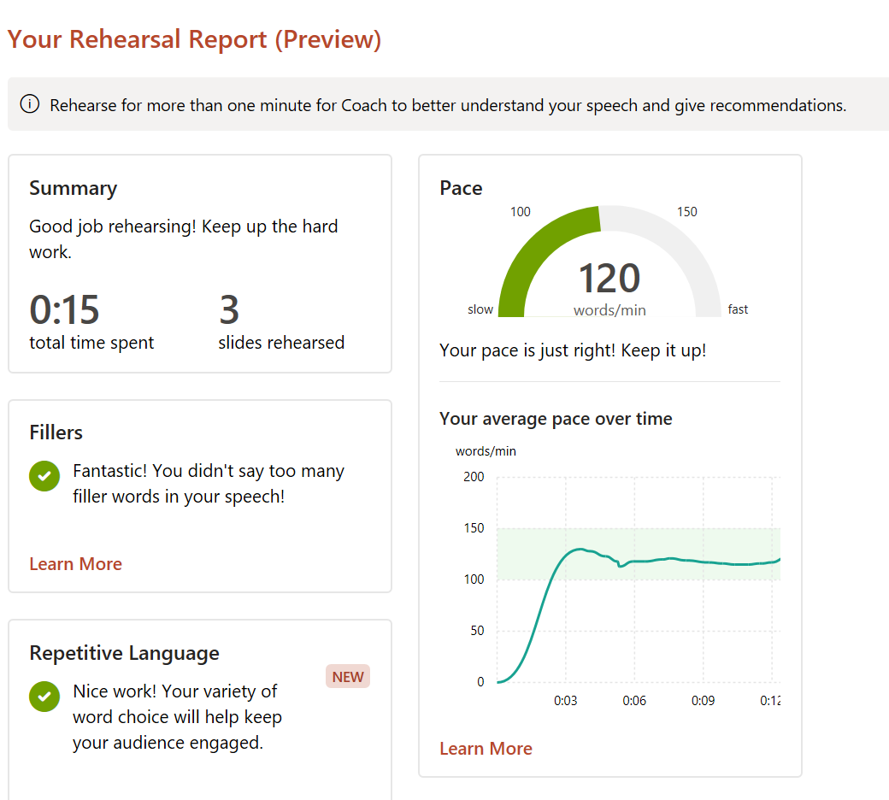
Rehearse with Coach
Slide Show > Rehearse with Coach

Slide 23
Act 7: Handling Q and A
Discuss in your team how to manage the following scenarios:
How to manage questions that I have no answers for?
Do I look at questioner or audience at large when answering questions?
How do I handle very lengthy and complex questions?
What is a preferred style and tone for presenters when answering questions?
Shall I take some time to think before I answer any question?

Slide 24
Assignment 2: Oral Presentation
Refer to Assignment 2 in coursebook
Read and understand task
Prepare a 5-min OP on your FYP report introduction.
Be ready to answer questions from your peers after OP.
Submit slides (softcopy) one day before OP via NTUlearn> Assignment>Assignment 2 folder

Slide 25
Summary
Purpose, audience and context
Content organization
Delivery skills
Visual aids
Managing Q and A
Post-lesson thoughts: How to apply all the knowledge and skills learned to real-life tasks of presentation?

Slide 26
Post-tutorial tasks
Read up on Unit 8 <Email-writing at the workplace>
Start preparing for Assignment 2
Sign up for preferred slots on Google Docs platform after this class

